Slide 1
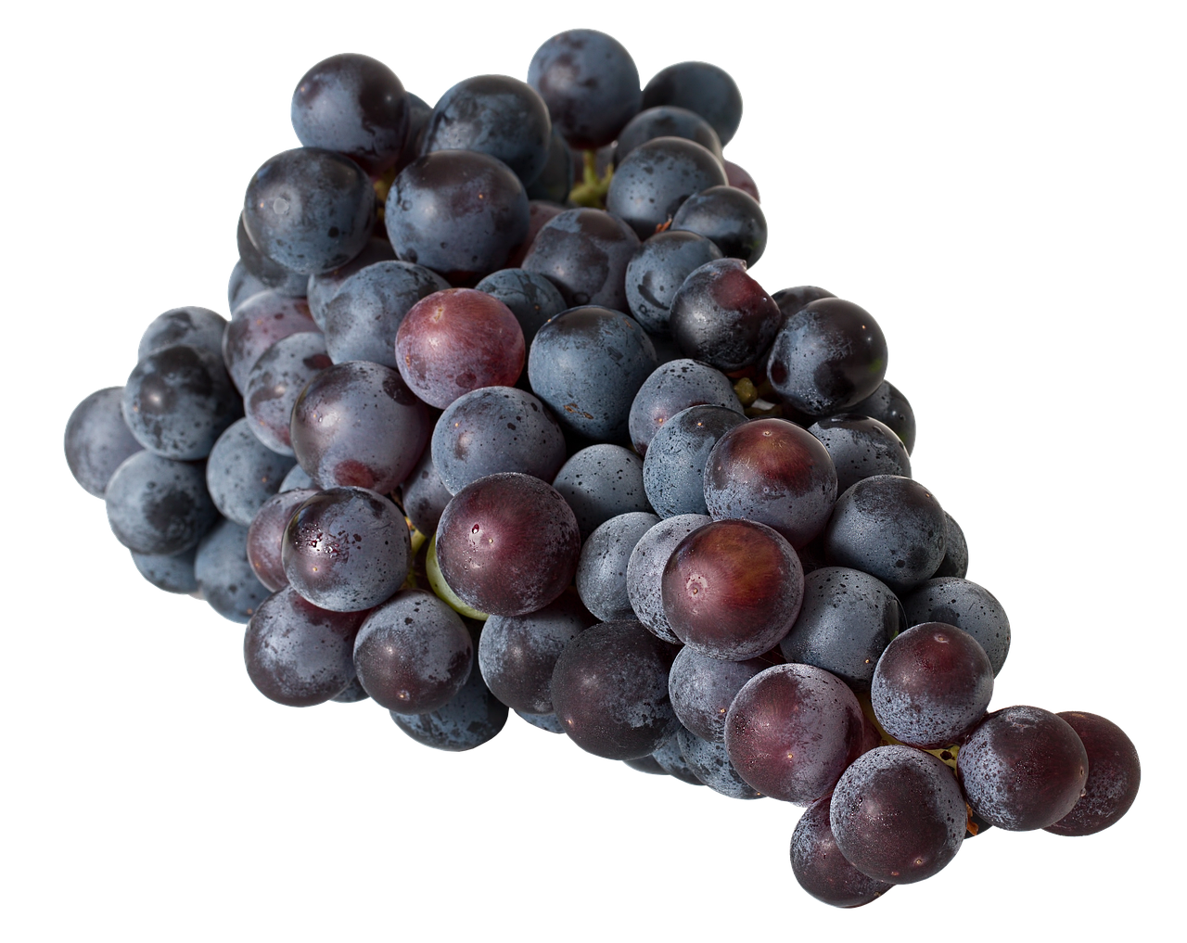
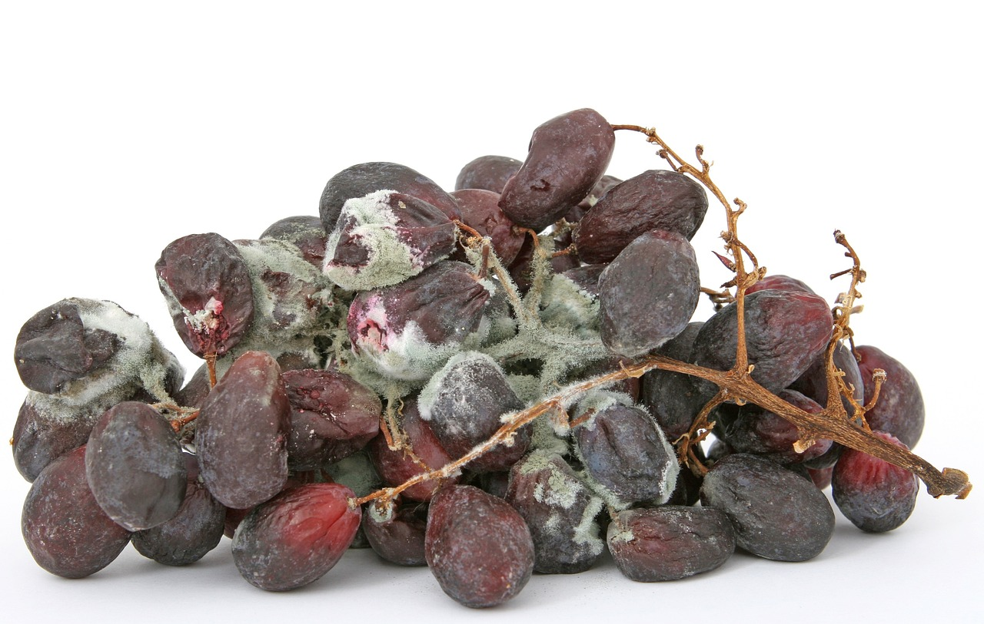
John 15: the total importance of Jesus
OT people (Israel)
NT people (Church)
JESUS!
NT people (Church)

Slide 2
John 15: the total importance of Jesus
1)
2)
More fruit with Jesus’ pruning!
No fruit without Jesus!
V1-2a
V2b-3
Summary:
V4

