Slide 2
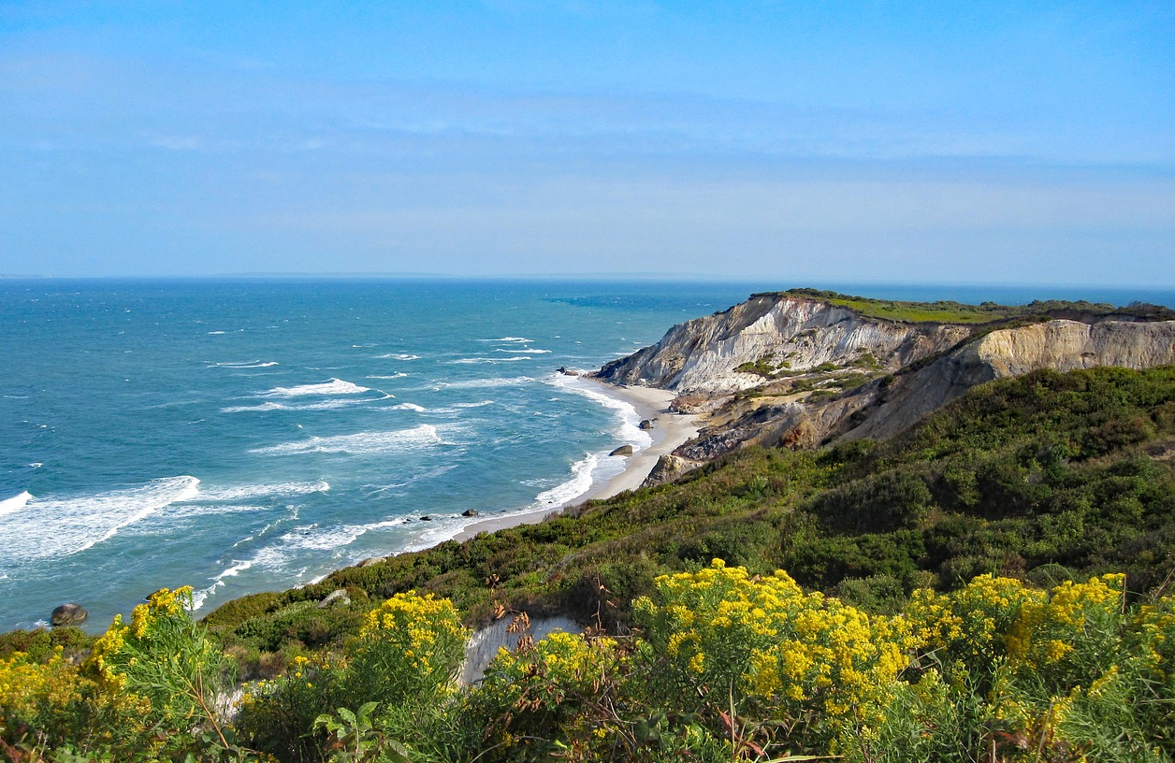
Text
Martha’s Vineyard

Slide 3
GREAT…
…GRAPE!!!!!
(Dad joke)

Slide 4
pleasing!
…GRAPE!!!!!
useful!

Slide 5
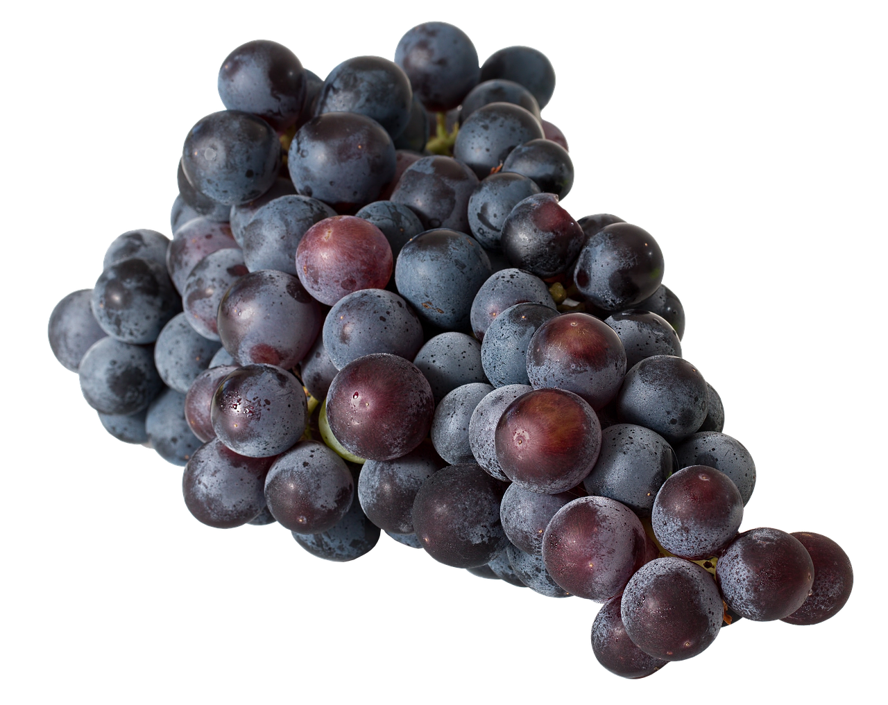
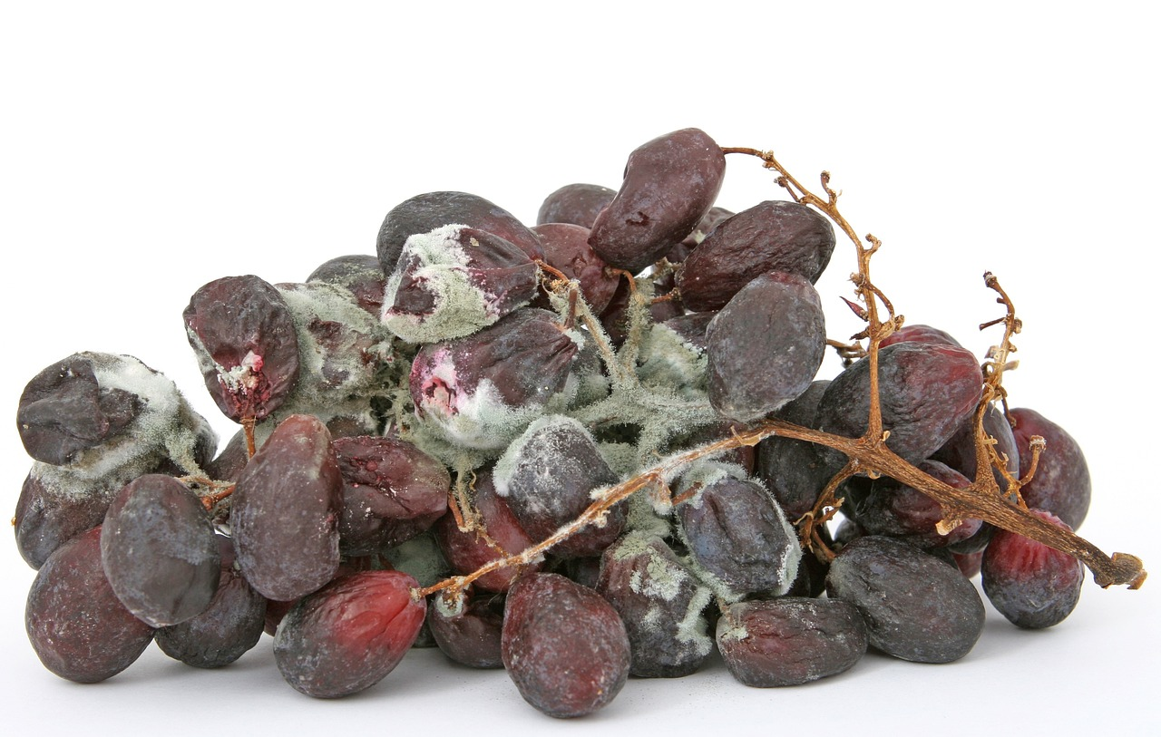
“he looked for a crop of good grapes but it yielded only bad fruit” Isa 5:2
“they will blossom like the vine” Hosea 14:7
pleasing!
useful!

